Slide 1
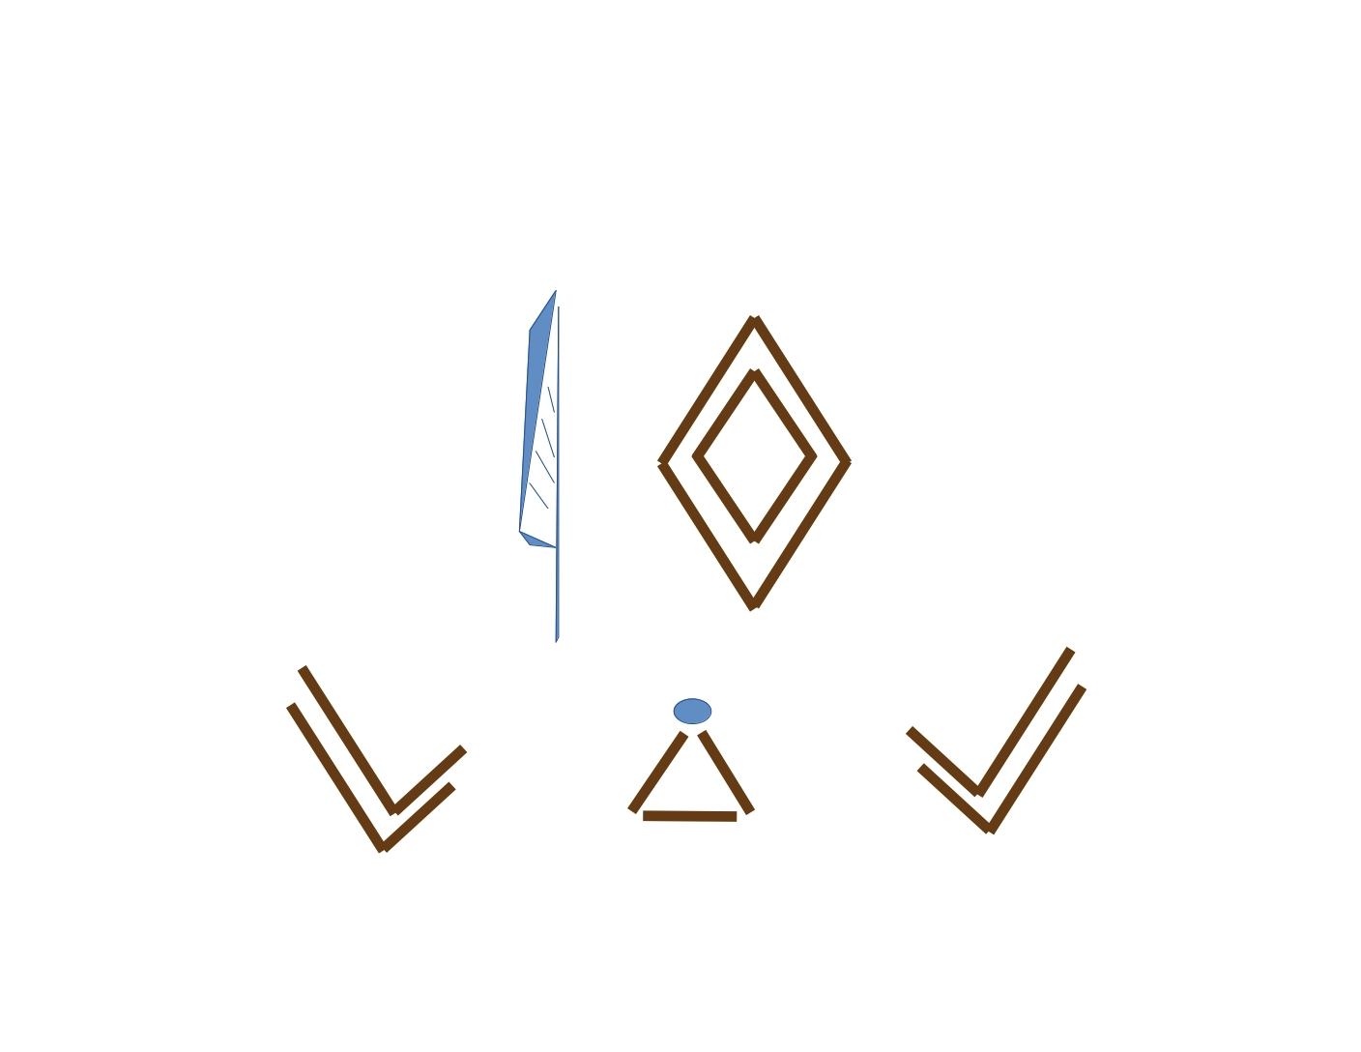
WIQA

Slide 2
Introduction
The following ciphers are designed to educate the user on the principles of Moon Arithmetic

Slide 3
Origin
Ancient Egyptian Vignettes

Slide 4
FTU
Pronounced FETU
Egyptian for the number four (4)
Write FTU on a sheet of paper, circle it

Slide 5
FTU
Write F T U on the line below
F = Multiplication
T = Addition
U = Subtraction
Spacing the letters of FTU = Division

Slide 6
FTU
Circling and crossing the T = XOR
XOR = Addition modulo 2
Addition modulo 2 =

Slide 7
Ciphers
WIQA B Cipher
WIQA BA Cipher
WIQA BB Cipher
WIQA BC Cipher
WIQA A Cipher

Slide 8
_
Mirror mirror on the wall, which cipher is the fairest of them all

Slide 9
_
KryptoMagick 2021

